Slide 1
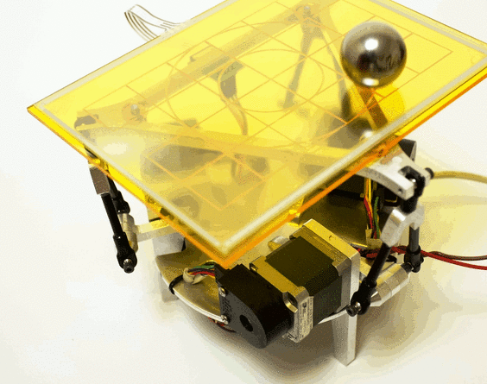


Ball On Plate
MECA 482 – 7534
Group 7
Ryan Brewer, Andrew Renteria, Alex Robie, Alex Roth, Josh Verdon

Slide 2
Introduction
The purpose of a ball and plate system is to balance a ball on a plate utilizing two stepper motors attached in line to the bottom of the plate. As the force of gravity is constant, the plate must make constant micro adjustments to ensure the ball does not fall or stays within a specified region.
The goal of this project is to design a controller for this system utilizing Control Systems literature and equations, MATLAB, Simulink, and CoppeliaSim.

Slide 3
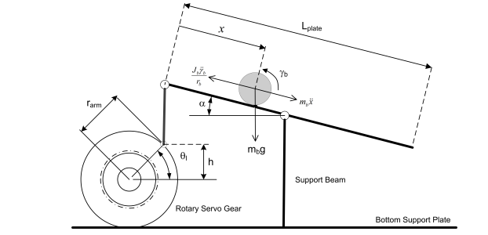



Modeling
The Ball and Plate mathematical model from 2 DOF Ball Balancer Workbook was utilized in conjunction with the equations for nonlinear and linear motion.
The Laplace of the linear equation is utilized to determine the transfer function.

Slide 4
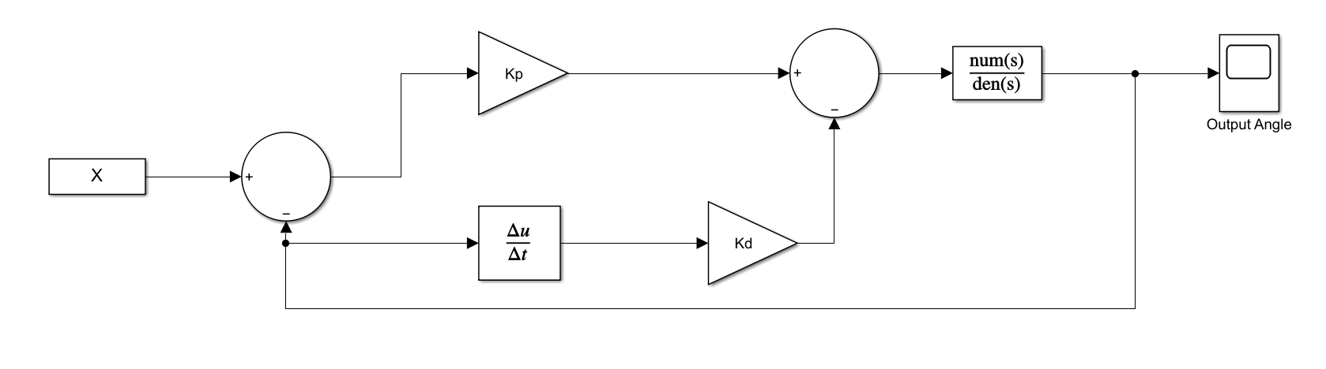




Control System Block Diagram
Block diagram controls servo position utilizing proportional and derivative gain, which can be calculated using the given equations.
NOTE: Must calculate damping ratio and natural frequency prior to solving for k_{p} and k_{d}

Slide 5
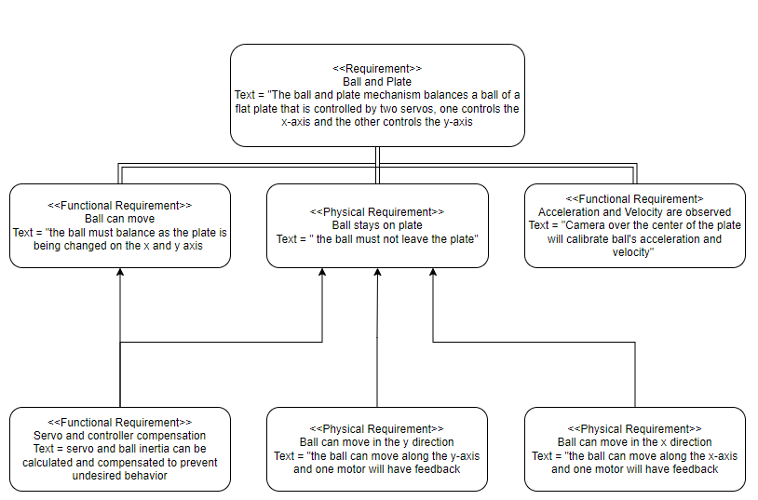
Working System Requirements

Slide 6
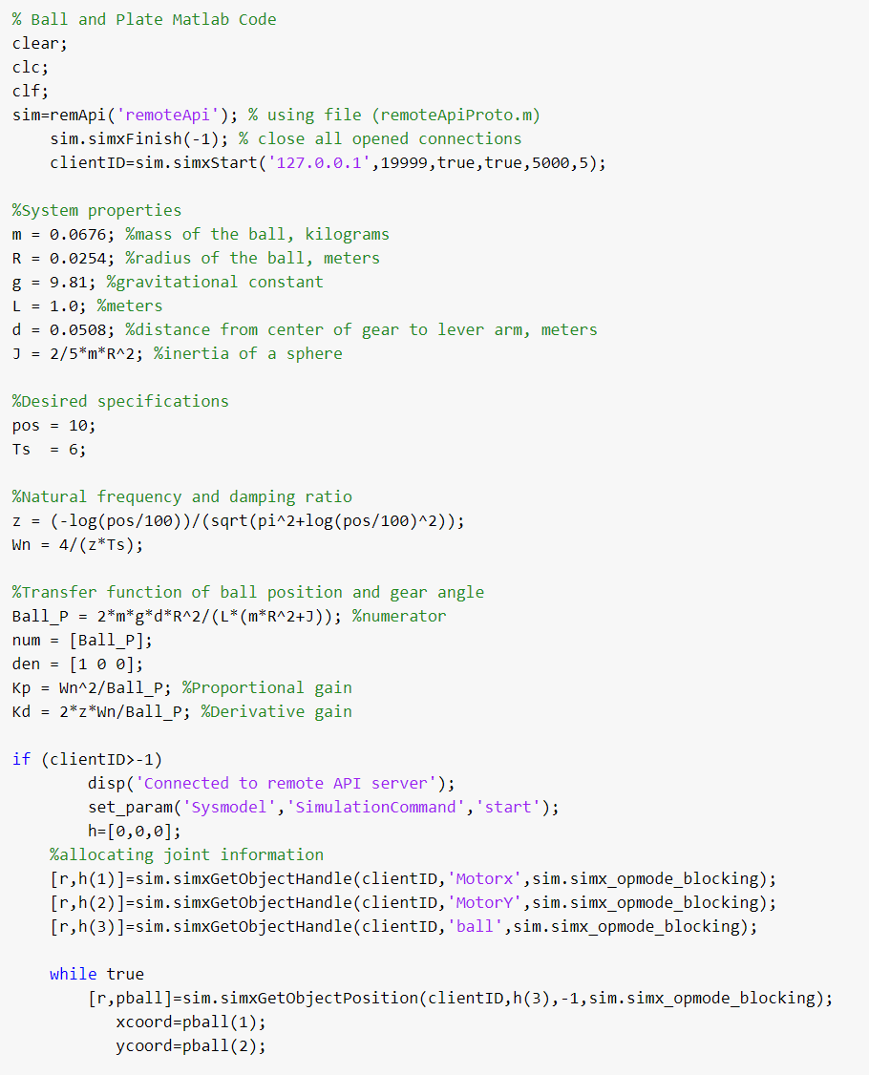
Controller Design and Simulation

Slide 7
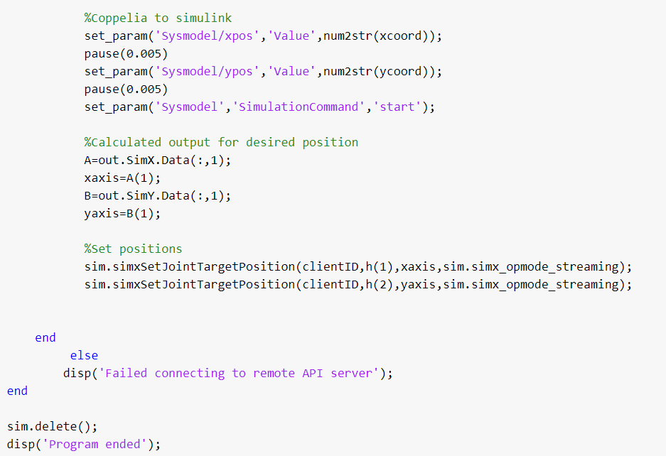
Controller Design and Simulation

Slide 8
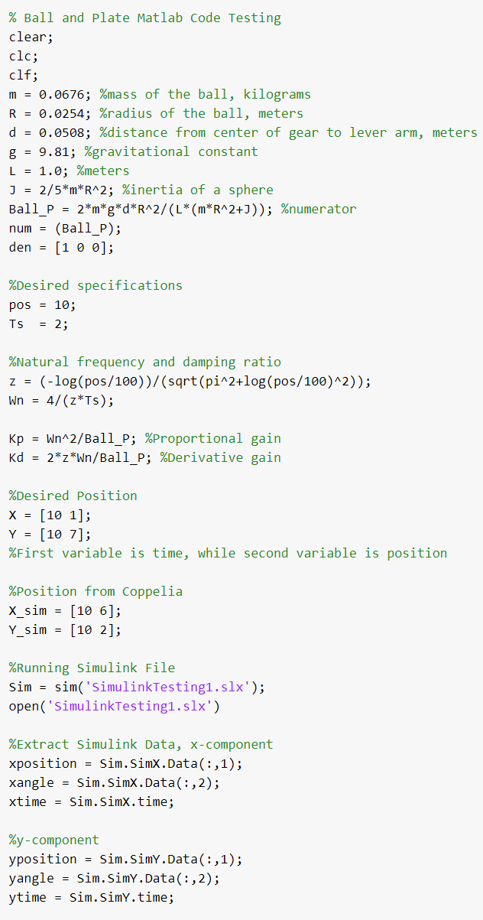
Controller Design and Simulation
Alterations were made due to the inability to link to CoppeliaSim.
NOTE: Manual switches were added due to the inability to properly configure the link between MATLAB and Coppelia.

Slide 9
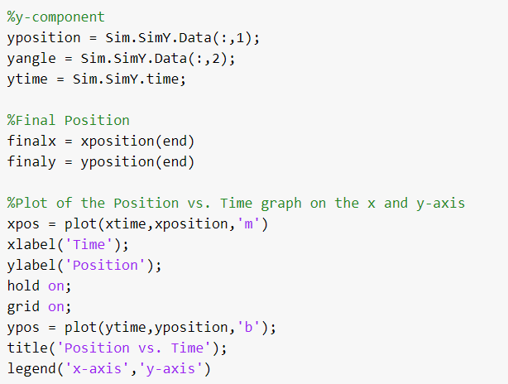
Controller Design and Simulation

Slide 10
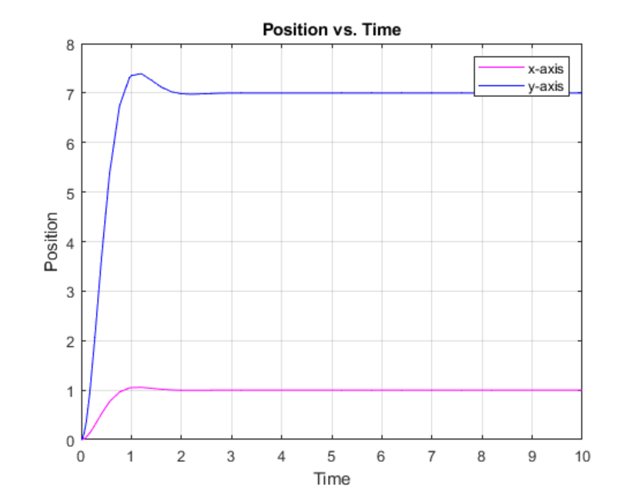
Controller Design and Simulation
The following is a graphical representation of the output data acquired from MATLAB for the balls position vs time within the system.
NOTE: x- and y- positions of ball are listed independently

Slide 11
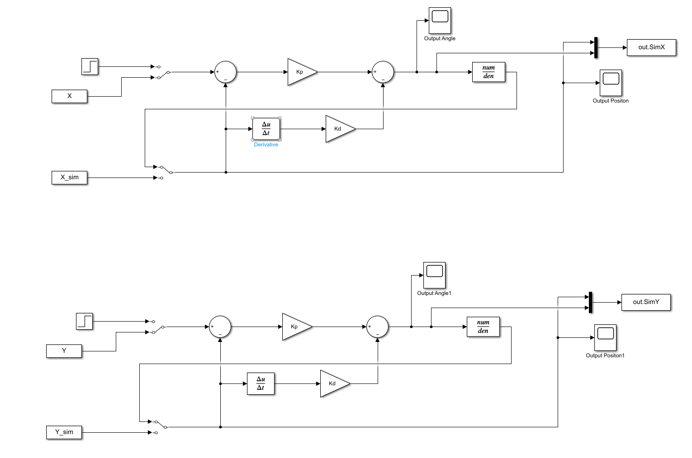
Controller Design and Simulation
Simulink
The figure displays the final Simulink result file implemented with Coppelia for the project.

Slide 12
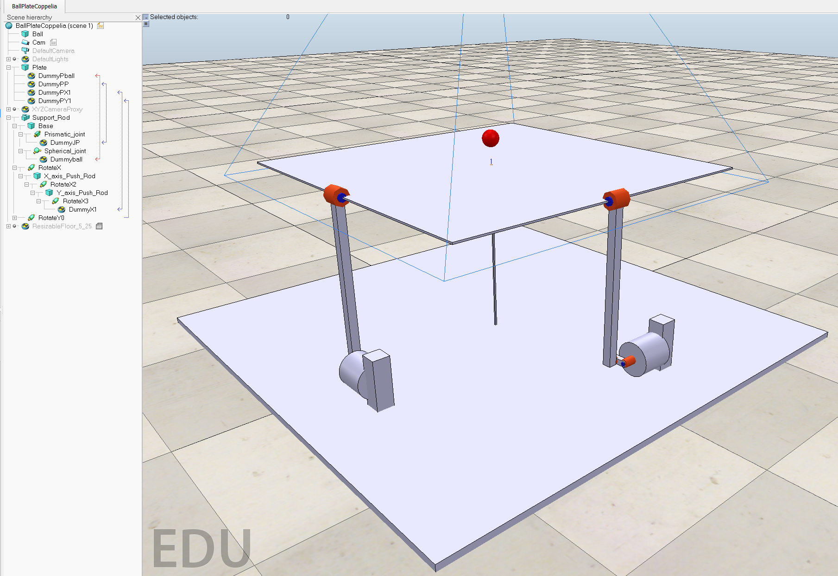
Controller Design and Simulation
Coppelia
The figure displays the Coppelia model used for the project.
Coppelia

